Slide 1
Pointers

Slide 2
Objectives
After studying this chapter, you should be able to:
Understand where program’s data can be putted
Explain what are pointers
Declare pointers in a program
Discuss about where pointers can be used
Understand operators on pointers
Implement functions in which pointers are parameters
Use build-in functions to allocate data dynamically

Slide 3
Contents
Review the memory structure of a program
Where can we put program’s data?
What are pointers?
Pointer Declarations
Why are pointers used?
Pointer operators
Assign values to pointers
Access data through pointer
Explain pointer arithmetic
Explain pointer comparisons
Pointers as parameters of a function
Dynamic Allocated Data

Slide 4
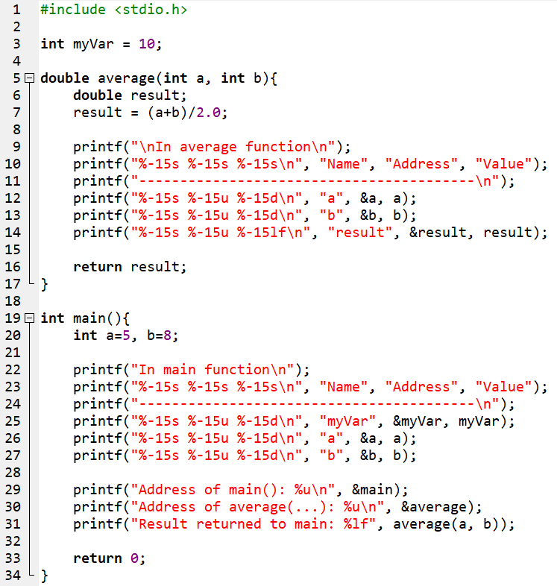
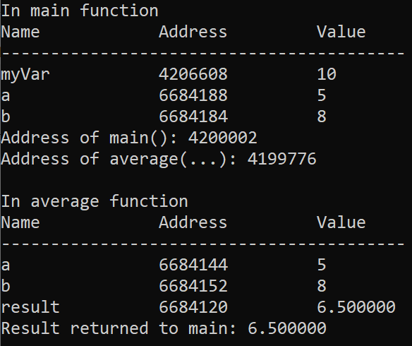
1 - Review the memory structure of a program
Data segment
42026608
myVar=10
Code segment
Code of main()
4200002
Code of average()
Memory mapping
4199776
HEAP
STACK
segment
6684188
a = 5
6684184
b = 8
6684152
b = 8
6684144
a = 5
66841120
result = 6.500000

Slide 5
Question
Data segment
42026608
myVar=10
Code segment
Code of main()
Address of a variable is a number. Can we assign this number to another variable then access data through the new variable?
4200002
Code of average()
4199776
HEAP
Address of a function is a number. Can we assign this number to another variable then call this function through the new variable?
Yes. We can access a data through it’s address and call a function through it’s address also. POINTER is a way to satisfy these requirement.
In this chapter, pointers of variables are concerned only.
STACK
segment
6684188
a = 5
6684184
b = 8
6684152
b = 8
6684144
a = 5
66841120
result = 6.500000

Slide 6
2 - Where can we put program’s data?
Data
Segment
Common Variables
All functions can access them
Global
Code
Segment
Dynamic
Heap
Dynamic allocated data through
explicitly statements for memory
allocation
Data
Local
Stack
Segment
Variables are defined in functions.
They will exist only when the
function is executed and they will
be removed when the function
Completed execution

Slide 7
3 - What is a Pointer?
A pointer is a variable, which contains the address of a memory location of another variable.
If one variable contains the address of another variable, the first variable is said to point to the second variable.
A pointer provides an indirect method of accessing the value of a data item.
Pointers can point to variables of other fundamental data types like int, char, or double or data aggregates like arrays or structures.

Slide 8
4 - Pointer variables
A pointer declaration consists of a base type and a variable name preceded by an *
Syntax:
Note: The created pointer will contain the address of the variable it points to, with the data type is dataType.
Example:
int *pI;
double *pD;
char *pC;
dataType *pointerName;

Slide 9
5 - Why are Pointers used?
Some situations where pointers can be used are:
To modify outside arguments of a function
To return more than one value from a function
To pass array and strings more conveniently from one function to another
To manipulate arrays easily by moving pointers to them instead of moving the arrays itself
To allocated memory and access it (direct memory allocation)

Slide 10
6 - Pointer Operators
How to | Operator | Example
Get address of a variable and assign it to a pointer | & | int n= 7; int *pn = &n; → assign address of n to pointer variable pn
Access indirectly value of a data through it’s pointer | * | *pn =100;
int n= 7;
int *pn = &n;
*pn = 100;
pn = &n; → pn = 6684188
*pn = 100; → Value at [6684188] = 100
6684188
n = 7
6684188
n = 7 → 100
6684176
pn
6684176
pn = 10000

Slide 11
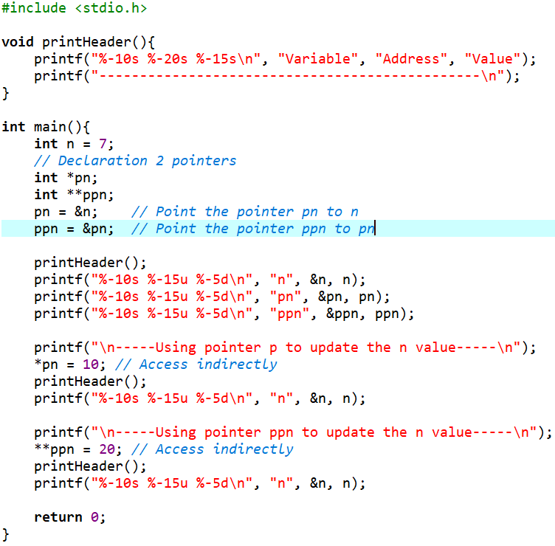
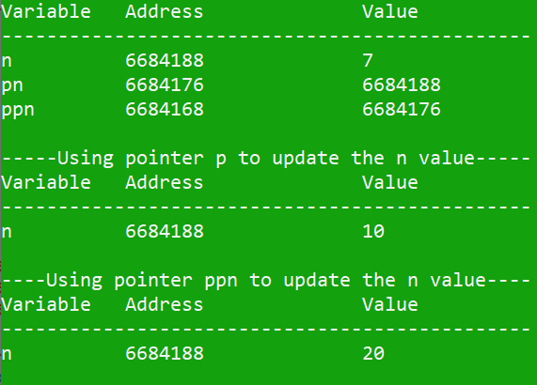
Pointer Operators: Example
n → int → pn stores address of n → pn: int*
pn → int* → ppn stores address of pn → ppn: (int*)* → ppn: int**
Result:

Slide 12
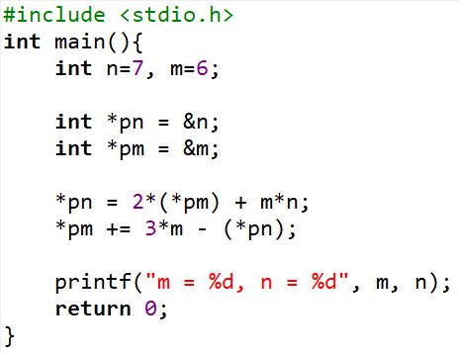

Pointer Operators: Walkthrough
address
memory-block
100
n=7 → 54
*pn = 2*(*pm) + m*n;
Value at 100 = 2*(value at 96) + m *n
Value at 100 = 2*6 + 6 *7
Value at 100 = 12 + 42 = 54
96
m=6 → -30
92
pn=100
1
88
pm= 96
1
2
*pm += 3*m - (*pn);
Value at 96 += 3*6 – value at 100
Value at 96 += 3*6 – 54
Value at 96 += 18 – 54
Value at 96 += (-36)
Value at 96 = 6 + (-36) = -30
2

Slide 13
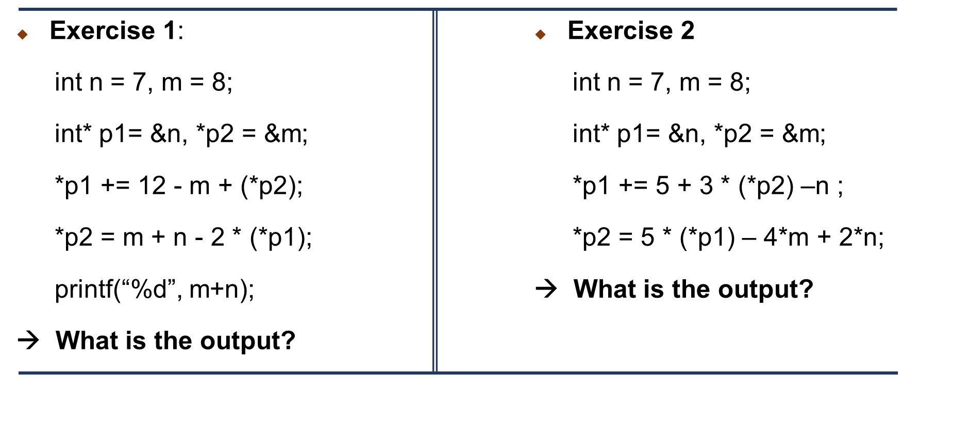
Exercises - Write code and Walkthrough

Slide 14
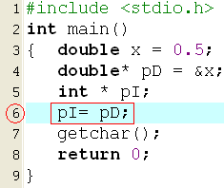

Attention about Accessing Pointers
Accessing data through pointers will manipulate on basic-data size.
Access int* → 4 bytes are affected.
Access char* → only 1 byte is affected.
Access double* → 8 bytes are affected.
Assign pointers which belong to different types are not allowed. If needed, you must explicitly casting.

Slide 15
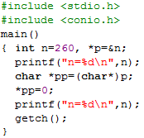

Attention…Pointers: Explicit Casting
Review: When a casting is performed, lowest byte is copied first then the higher bytes.
0000 0000
0000 0000
0000 0001
0000 0100
500/ n
0000 0000
p
500
500
pp
Manipulate on 4 bytes
Manipulate on 1 byte only

Slide 16
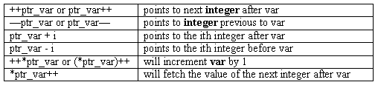
Pointer Arithmetic Operators
Each time a pointer is incremented, it points to the memory location of the next element of its base type.
Each time it is decremented it points to the location of the previous element.
All other pointers will increase or decrease depending on the length of the data type they are pointing to.

Slide 17
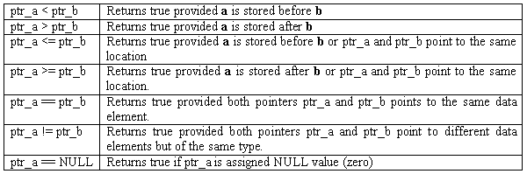
Pointer Comparisons
Two pointers can be compared in a relational expression provided both the pointers are pointing to variables of the same type.
Consider that ptr_a and ptr_b are 2 pointer variables, which point to data elements a and b. In this case the following comparisons are possible:

Slide 18
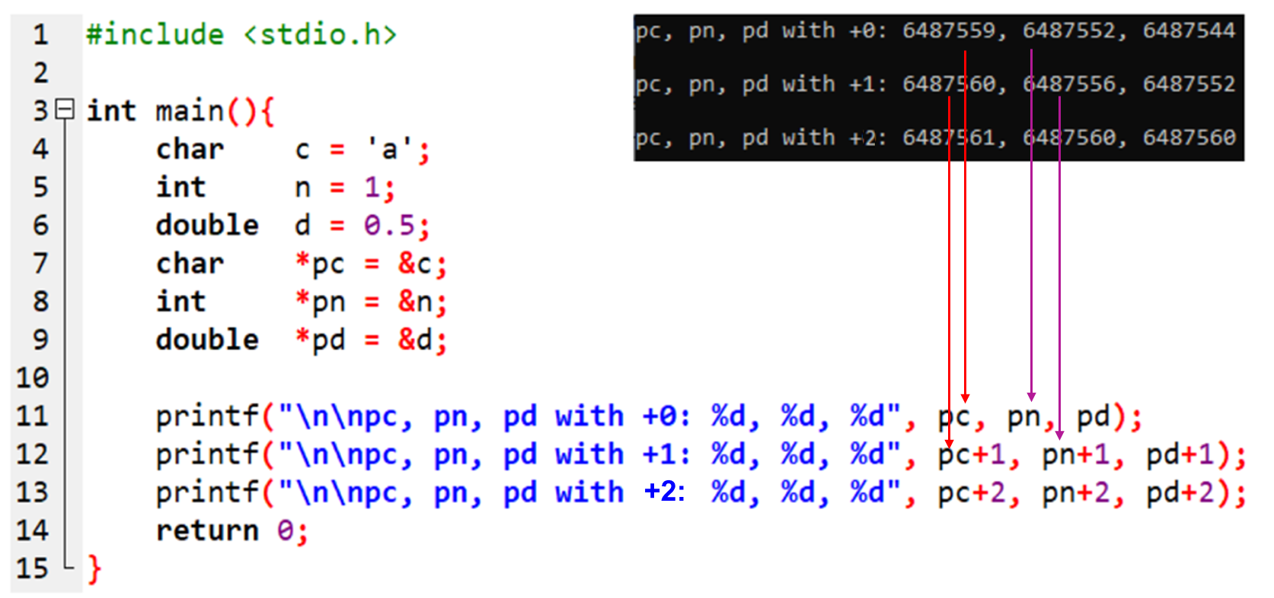
Pointer Arithmetic Operators: Example

Slide 19
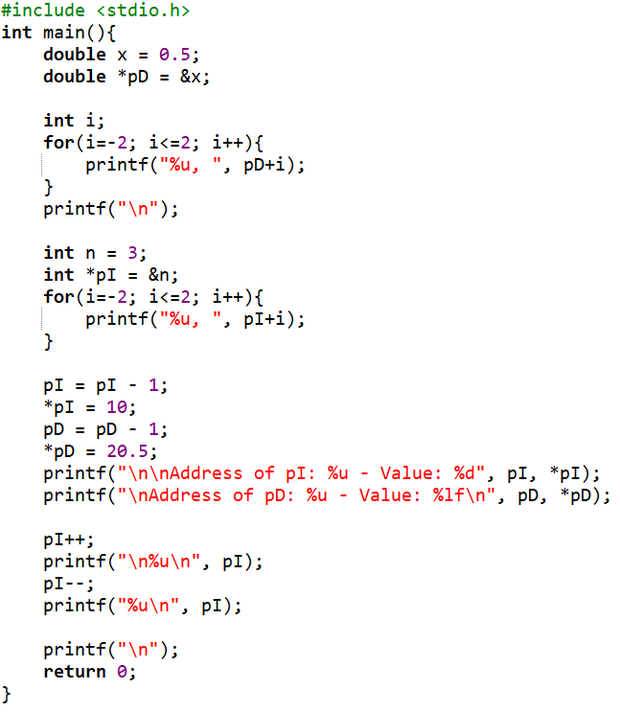
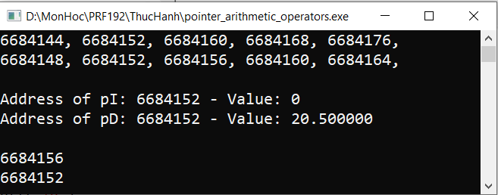
Pointer Arithmetic Operators: Example
Pointer + i → Pointer + (i*sizeof(baseType))
If access data using pI (bytes) can cause harm to the variable
6684176
6684168
x=0.5
6684164
6684160
6684160
6684156
6684152
6684152
n=3
6684148
6684144

Slide 20
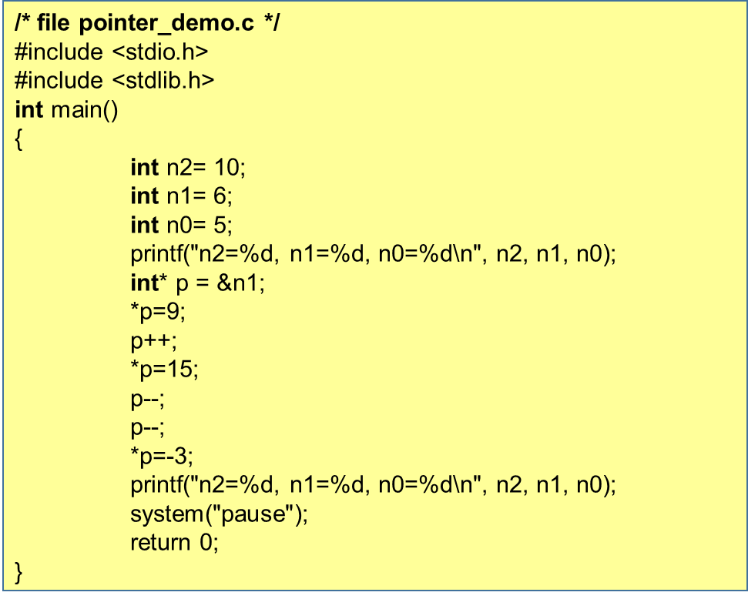
Exercise 3: Accessing the neighbor
Rewrite, run the program and explain the result.

Slide 21
Exercises
Exercise 4:
Exercise 5:
long*p;
Suppose that a long number occupies the memory block of 4 bytes
And p stores the value of 1000.
What are the result of the following expression? p+8 p-3 p++
char*p;
Suppose that a character occupies the memory block of 1 byte
and p stores the value of 207000.
What are the result of the following expression? p+8 p-3 p++

Slide 22
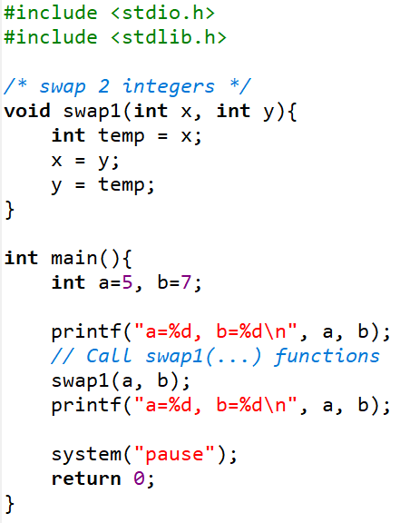

7 - Pointers as Parameters of a Function
Problem: C passes arguments to parameters by values only → C functions can not modify outside data.
y = 7 →5
x = 5 → 7
t = 5
a = 5
b = 7

Slide 23
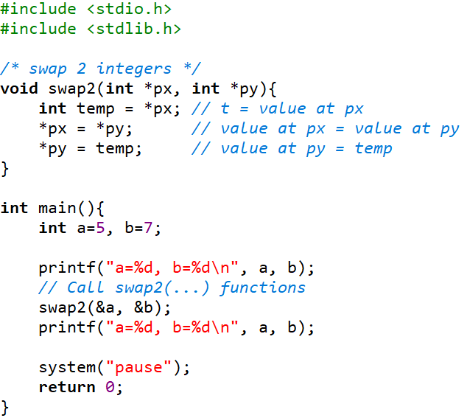

7 - Pointers as Parameters of a Function (cont.)
Solution: Use pointer arguments, we can modify outside values
py: 996
px : 1000
t = 5
a = 5 → 7
1000
b = 7 → 5
996

Slide 24
8 - Dynamic Allocated Data
In C allows you to allocate memory during runtime using functions provided in the standard library.
It is particularly useful when the size of the data is not known at compile time.
Dynamic memory is managed via pointers, and you can allocate and deallocate memory as needed.
Standard library functions: stdlib.h
size_t: Another name of the int type. It is used in case of memory allocation managing.
void* calloc (size_t numberOfItem, size_t bytesPerItem)
void* malloc (size_t numBytes) ;
void* realloc (void* curPointer, size_t newNumBytes);
void free(void* willBeDeletedPointer);
void is the general datatype which means that the data type is not determined yet. So, user must give an explicit casting when it is used.

Slide 25
Dynamic Allocated Data (cont.)
Data
Segment
Global
Code
Segment
Example:
int* p = (int*) malloc (sizeof (int)) ;
*p=2;
….
free(p);
Dynamic
Heap
Data
Local
Stack
Segment

Slide 26
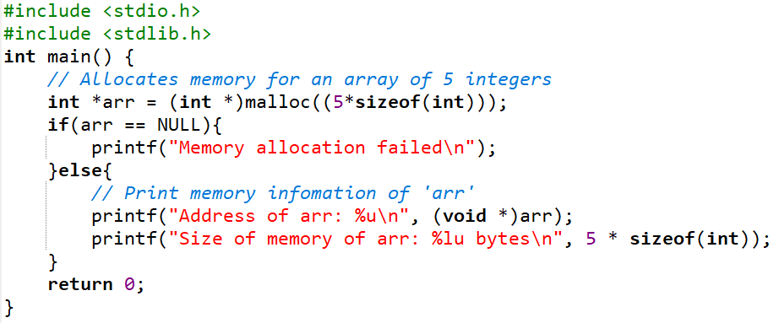

malloc (Memory Allocation)
Allocates a specified number of bytes and returns a pointer to the allocated memory. The memory is uninitialized, meaning it may contain garbage values.
Syntax:
Example:
void *malloc(size_t size);

Slide 27
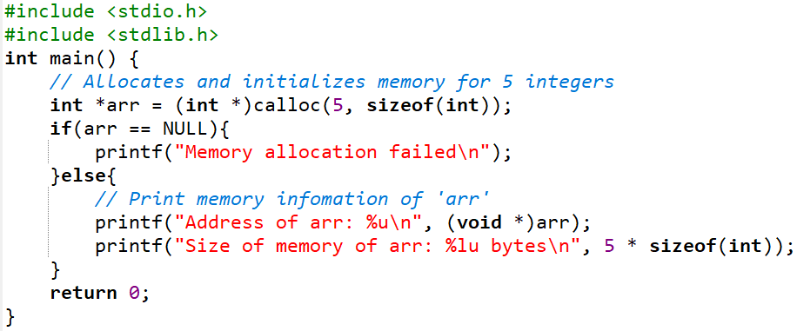

calloc (Contiguous Allocation)
Allocates memory for an array of elements and initializes all bytes to zero.
Syntax:
Example:
void *calloc(size_t num, size_t size);

Slide 28
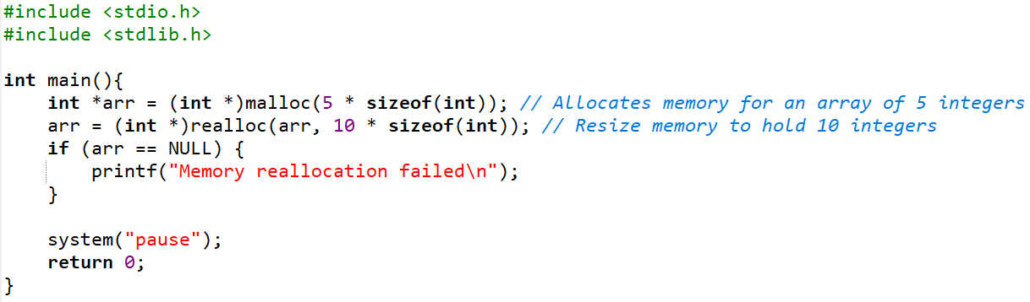
realloc (Reallocation)
Resizes an already allocated memory block. It can shrink or expand the memory block. If it expands the block, the new memory might be uninitialized.
Syntax:
Example:
void *realloc(void *ptr, size_t size);

Slide 29
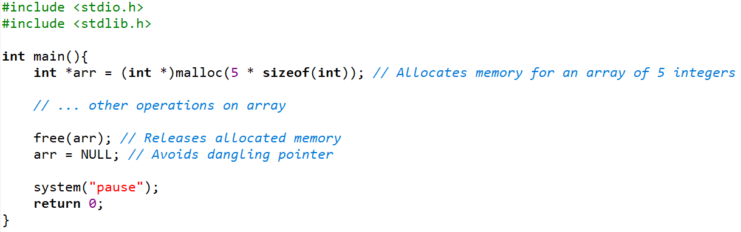
free (Deallocation)
Frees memory previously allocated with: malloc, calloc, realloc
Syntax:
Example:
void free(void *ptr);

Slide 30
Dynamic Allocated Data: Demo 1
#include <stdio.h>
#include <stdlib.h>
const int MAXN =100;
int main()
{
int n; int *p1; int *p2; int *p3;
printf("Address of MAXN: %u\n", &MAXN);
printf("Main function ia allocated at: %u\n", &main);
printf("Address of n : %u\n", &n);
printf("Address of p1: %u\n", &p1);
printf("Address of p2: %u\n", &p2);
p1 = (int*)malloc(sizeof(int));
p2 = (int*)malloc(sizeof(int));
p3 = (int*)malloc(sizeof(int));
printf("Dynamic allocation (p1) at: %u\n", p1);
printf("Dynamic allocation (p2) at: %u\n", p2);
printf("Dynamic allocation (p3) at: %u\n", p3);
free(p1);
free(p2);
system("pause");
return 0;
}
(1) Copy, past, compile and run the program.
(2) Draw the memory map.
(3) Show that where is data segment, code segment, stack segment and heap of the program.
(4) Give comment about the direction of dynamic memory allocation.
Requirement

Slide 31
Dynamic Allocated Data: Demo 2
Use dynamic memory allocation. Develop a program that will accept two real numbers then sum of them, their difference, their product, and their quotient are printed out.
Do yourself:
/* main() */
double *p1, *p2;
p1 = (double*) malloc ( sizeof(double));
p2 = (double*) malloc ( sizeof(double));
printf(“p1, address: %u, value: %u\n”, &p1, p1);
printf(“p2, address: %u, value: %u\n”, &p2, p2);
printf(“Input 2 numbers:”);
scanf( “%lf%lf”, p1, p2);
printf(“Sum: %lf\n”, *p1 + *p2);
printf(“Difference: %lf\n”, *p1 - *p2);
printf(“Product: %lf\n”, *p1 * (*p2));
printf(“Quotient: %lf\n”, *p1 / *p2);
(1) Run this program
(2) Draw the memory map (stack, heap).
Requirement

Slide 32
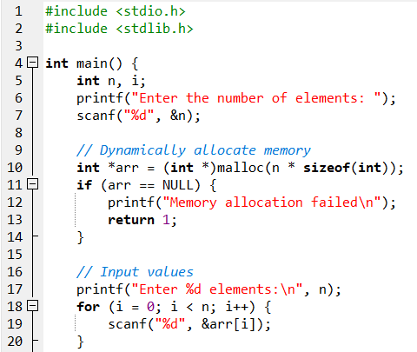
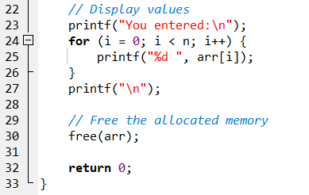
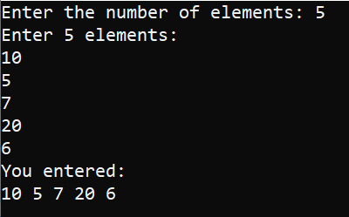
Dynamic Allocated Data: Demo 3

Slide 33
Dynamic Allocated Data: Note
Always check if the pointer returned by malloc, calloc, or realloc is NULL to avoid dereferencing a null pointer.
Always use free to deallocate dynamically allocated memory when it's no longer needed.
Avoid memory leaks by freeing all allocated memory.
Avoid using free on pointers that were not dynamically allocated.

Slide 34
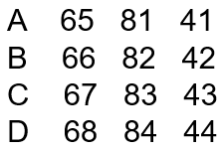
Exercise 6:
Write a C program using dynamic allocating memory to allow user entering two characters then the program will print out characters between these in ascending order.
Example:
Input: DA
Output:
After the program executes, draw the memory map of the program.

Slide 35
Summary
Review the memory structure of a program
Where can we put program’s data?
Why are pointers?
Pointer Declarations
Where are pointers used?
Pointer operators
Assign values to pointers
Access data through pointer
Explain pointer arithmetic
Explain pointer comparisons
Pointers as parameters of a function
Dynamic Allocated Data

